Slide 1
Phishing URL Prediction Using Binary Classification
Mega Event EDA ML Model Activity :: Surge Classes
(17.06.2023)
Team Members :
K.V.N.Aditya
P.Sai Karthik
P.Phanindra
M.Venu
B.Lokesh Reddy

Slide 2
Objective
… the objective of our project is to determine whether the URL is a phishing or legitimate by using​ binary classification models​

Slide 3
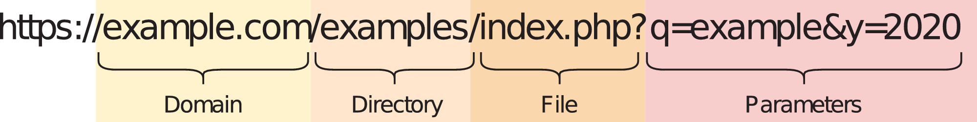
Data Description
The URL is mainly categorized into 4 categorizes:
Domain
Directory
File
Parameters
The dataset is categorized into 6 categorizes by following: …

Slide 4
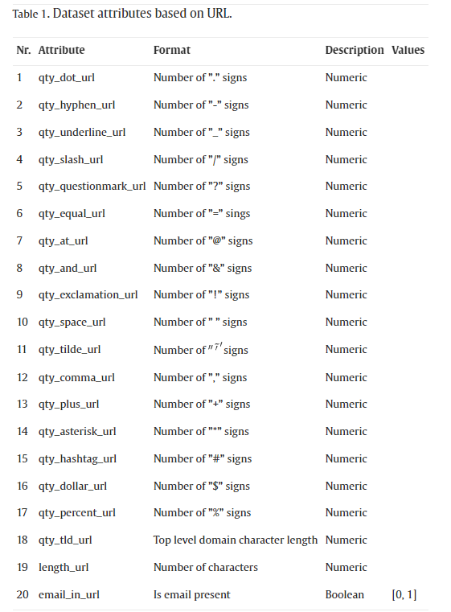
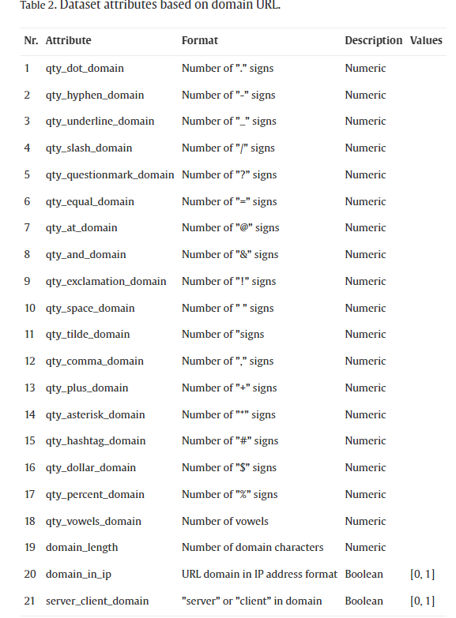
Data Description

Slide 5
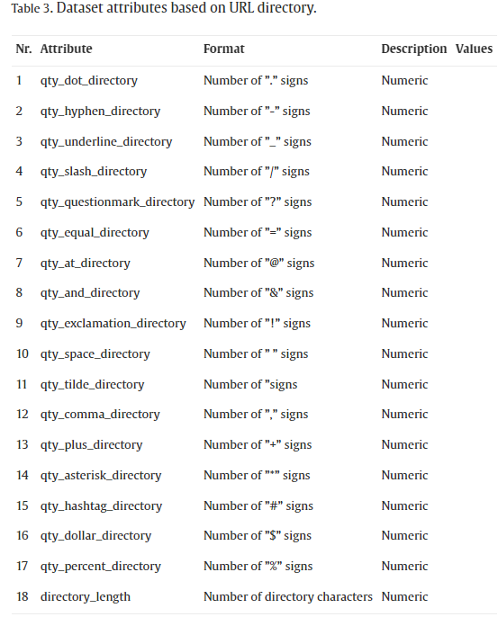
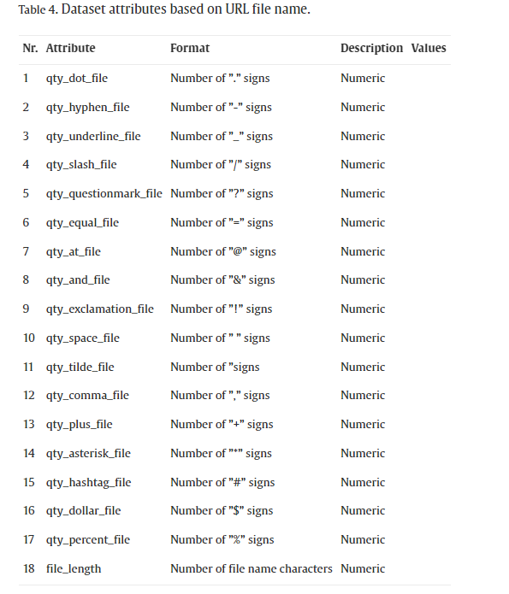
Data Description

Slide 6
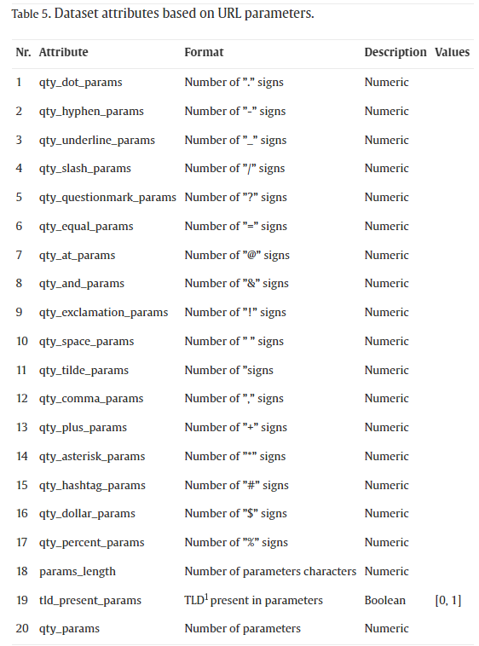
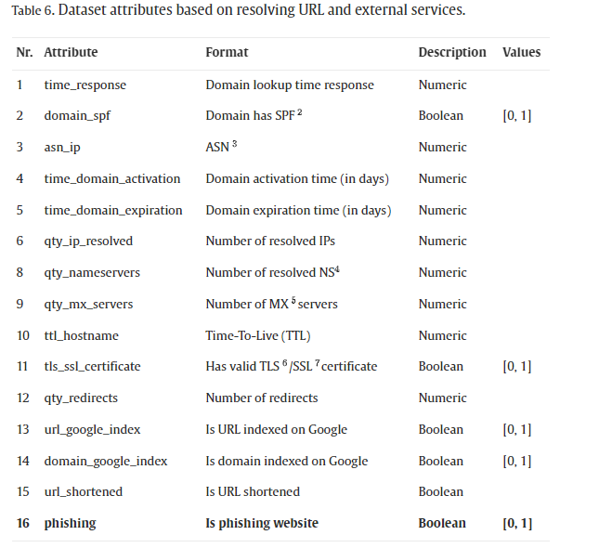
Data Description

Slide 7
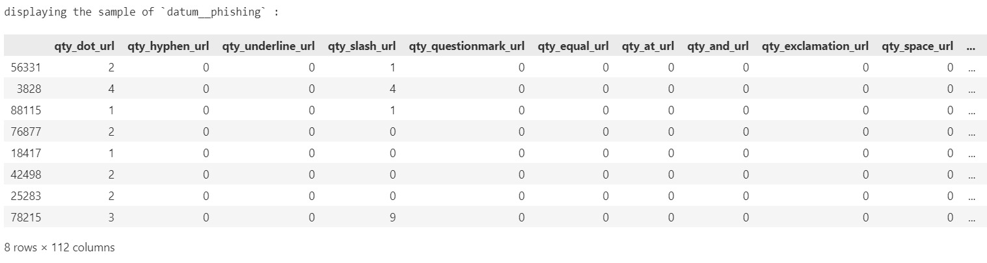
Exploratory Data Analysis (EDA)
Dimensions of the dataset:
Records : 88647
Attributes : 112
Displaying the sample dataset:

Slide 8
Exploratory Data Analysis (EDA)
Count of datatypes w.r.t the columns:(as per data dictionary) :
int64: 101
bool : 10
float64 : 1
Total sum of Null values in the dataset : 0
Total sum of duplicate records in the dataset: 1438
The dataset consists of one dependent variable “phishing” and 111 independent variables

Slide 9
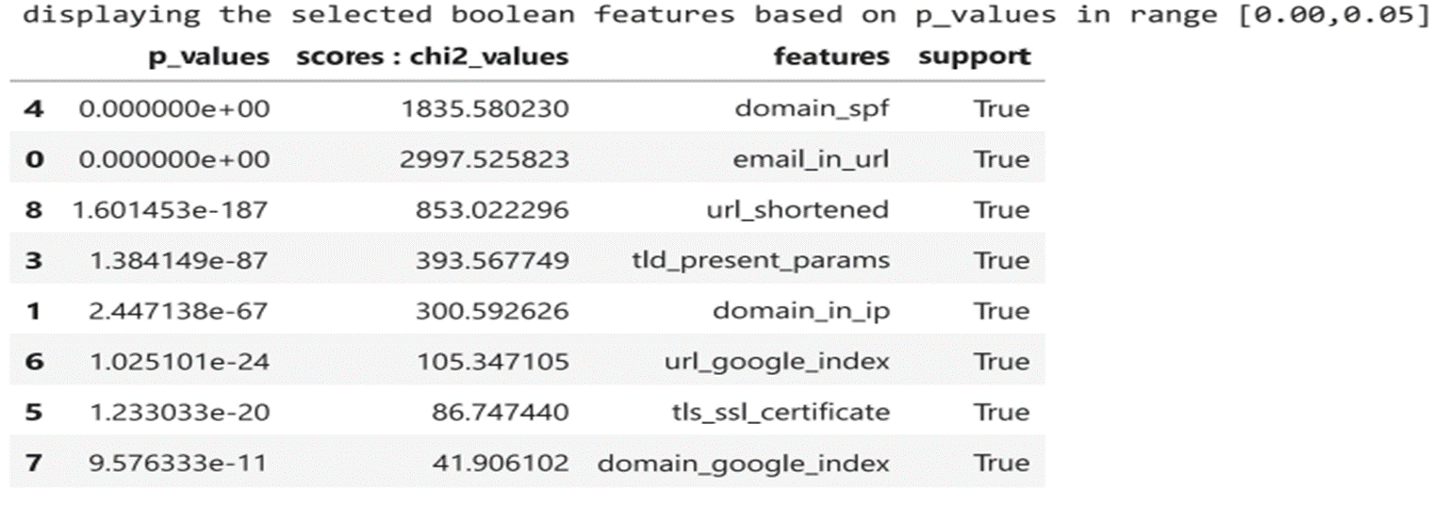
Processing
Assigning the target variable: “phishing” and dropping from the dataset.
Selecting the features by using “SelectKBest” by passing “chi-square” test for ‘Boolean-Boolean’ dtypes and “mutual_info_classif()” for “numerical-Boolean” dtypes.
Selecting the “Boolean-Boolean” features based on the p-values in range[0.00,0.05]
Total number of selected features in Boolean-Boolean: 8
Displaying the sample selected Boolean features based on ‘p_values’ in range [0.00,0.05]

Slide 10
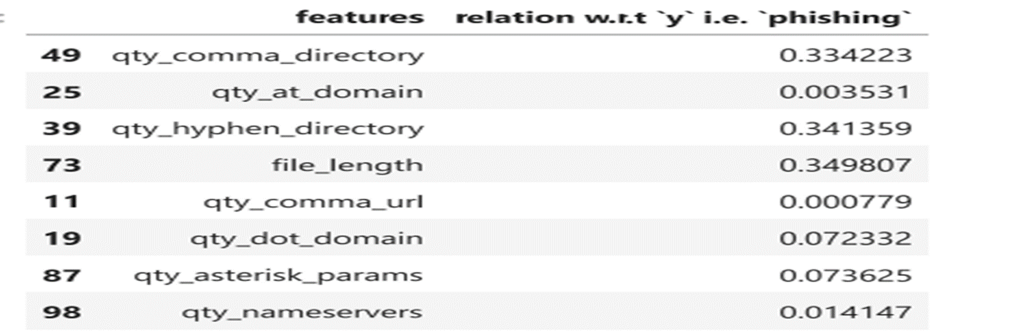
Processing
Selecting the ‘numeric-Boolean’ features based on the ‘mean’ of the correlation .i.e. mean is: 0.15099686208478547.
Total number of selected features in num-bool : 40
Displaying the sample selected Numerical features based on the ‘mean’ of the correlation:

Slide 11
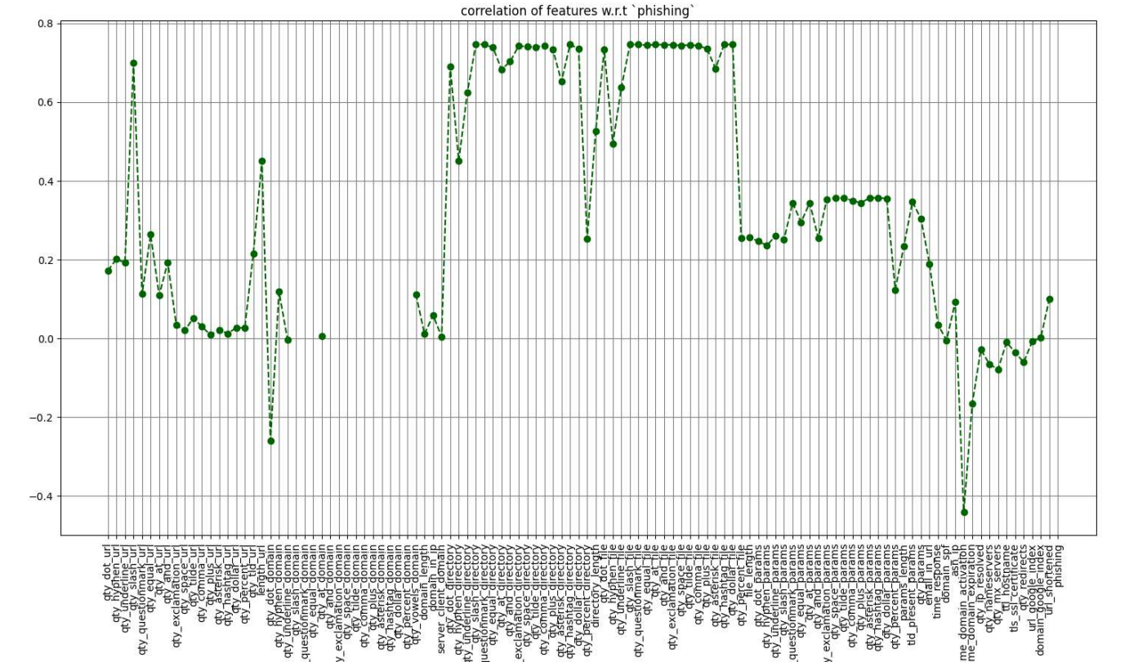
Processing
plotting the correlation of all features

Slide 12
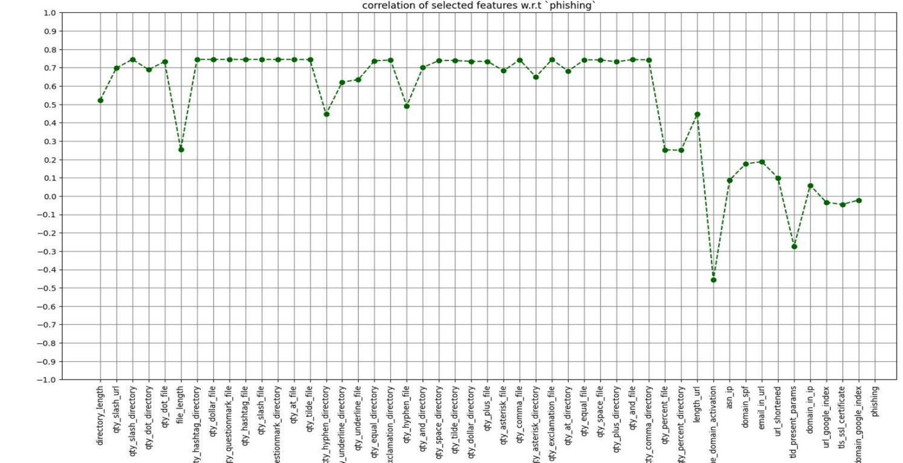
Processing
plotting the correlation of selected features:

Slide 13
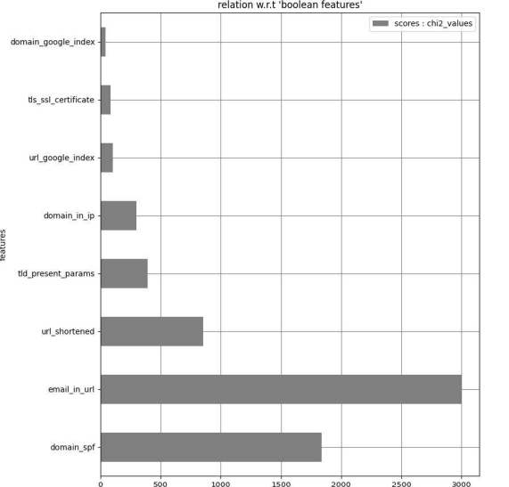
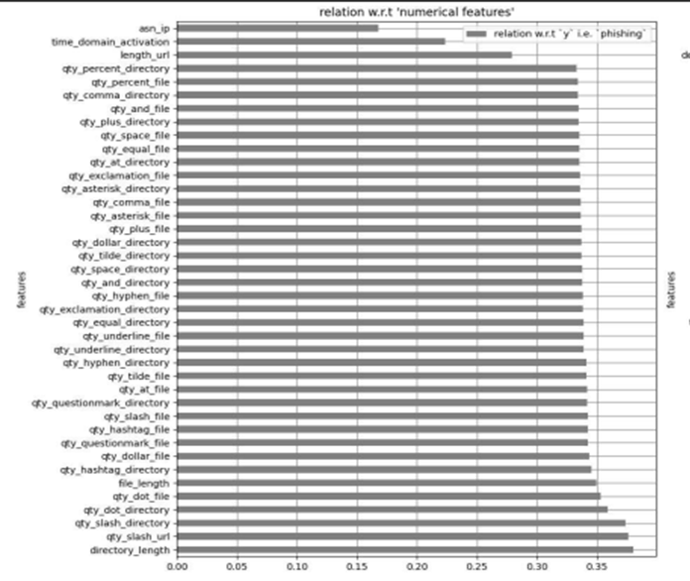
Processing
plotting the correlation of the selected Boolean features w.r.t the dependent variable:
plotting the correlation of the selected Numerical features w.r.t the dependent variable:

Slide 14
Processing
Number of selected features from each of the dataset categories:
Number of features selected from ‘df__phishing_wtr_url’ : 3
Number of features selected from ‘df__phishing_wtr_domainurl’ : 1
Number of features selected from ‘df__phishing_wtr_urldirectory’: 18
Number of features selected from ‘df__phishing_wrt_urlfilename’: 18
Number of features selected from ‘df__phishing_wrt_urlparameters’:1
Number of features selected from‘df__phishing_wrt_resolvingurl_externalservices’ : 7

Slide 15
Model Building
without feature selection:
train_test_split:
parameters:{test_size=0.5, random_state = 0}
return values : {x_train: (43604, 111),x_test: (43605, 111),y_train: (43604,),y_test: (43605,)}
model initializations:
Navie Bayes :: BernoulliNB
parameters : {}
Logistic Regression:
parameters:{max_iter = 11, random_state = 0}
Decision Classifier:
parameters :{random_state = 0}
Random Forest Classifier:
parameters:{random_state = 0}
K-Nearest Neighbor:
parameters:{}
Support Vector Machine (SVM) :: Support Vector Classifier (SVC)
parameters : {random_state = 0}

Slide 16
Model Building
with feature selection:
train_test_split:
parameters:{test_size=0.5, random_state = 0}
return values : {x_train: (43604, 111),x_test: (43605, 111),y_train: (43604,),y_test: (43605,)}
model initializations:
Navie Bayes :: BernoulliNB
parameters : {}
Logistic Regression:
parameters:{max_iter = 11, random_state = 0}
Decision Classifier:
parameters :{random_state = 0}
Random Forest Classifier:
parameters:{random_state = 0}
K-Nearest Neighbor:
parameters:{}
Support Vector Machine (SVM) :: Support Vector Classifier (SVC)
parameters : {random_state = 0}

Slide 17
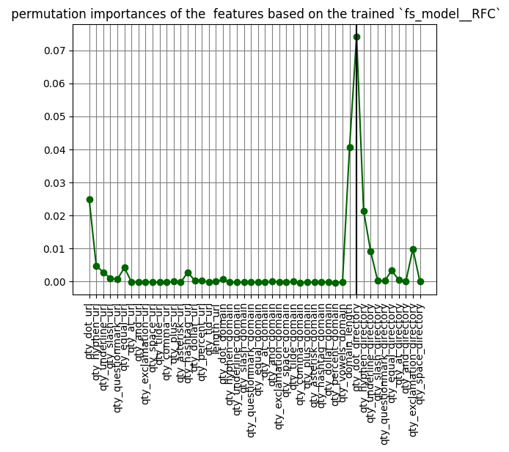
Model Metrics
plotting the permutation_importance of the features based on trained models (w.r.t ‘RFC’):

Slide 18
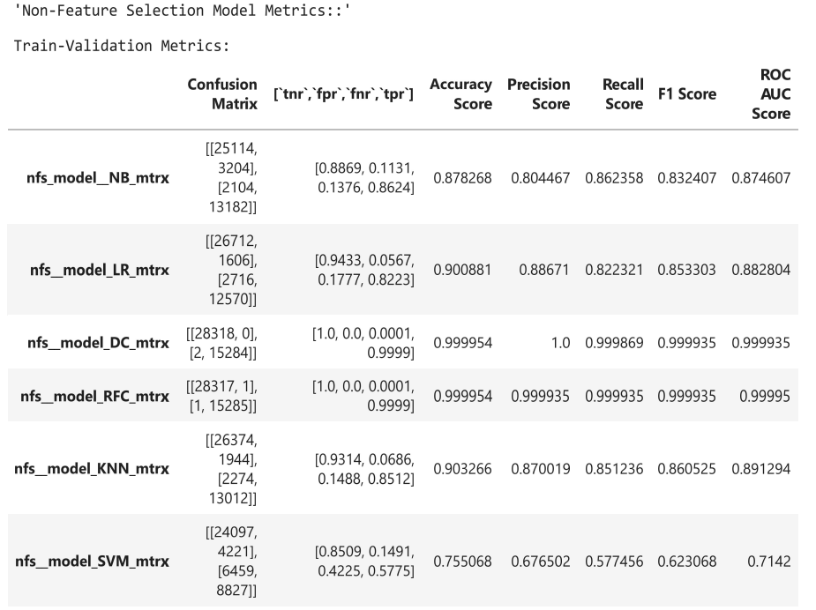
Model Metrics
without feature selection model metrics :
train_validation metrics:

Slide 19
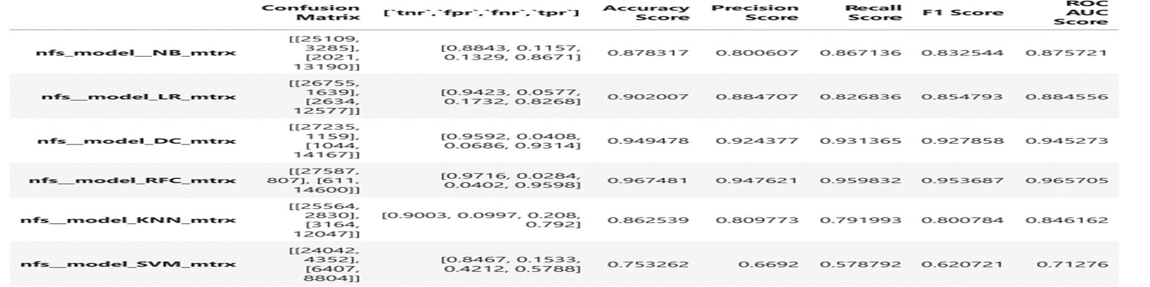
Model Metrics
without feature selection model metrics :
test metrics:

Slide 20
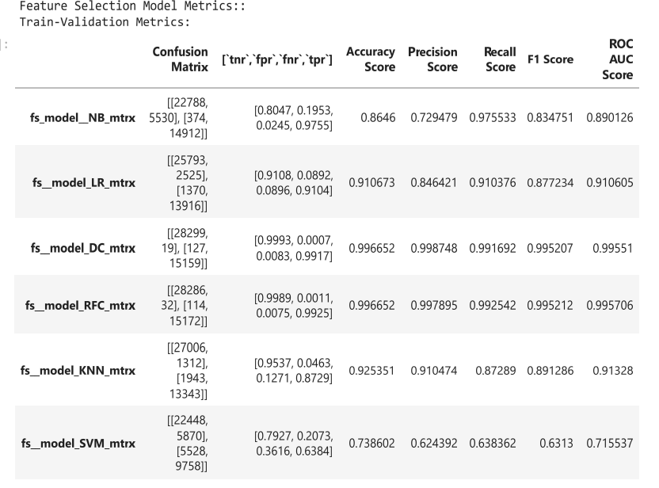
Model Metrics
with feature selection model metrics :
train_validation metrics:

Slide 21
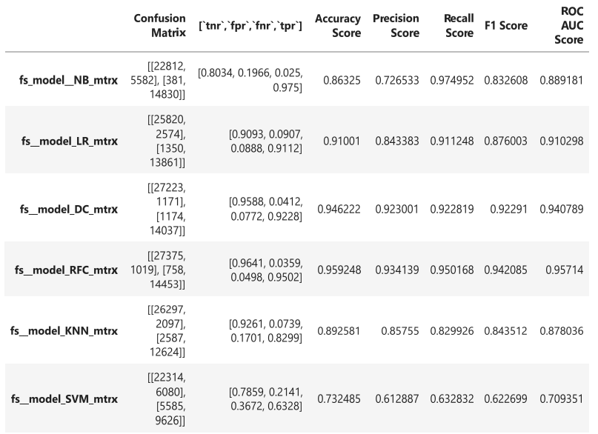
Model Metrics
with feature selection model metrics :
test metrics:

Slide 22
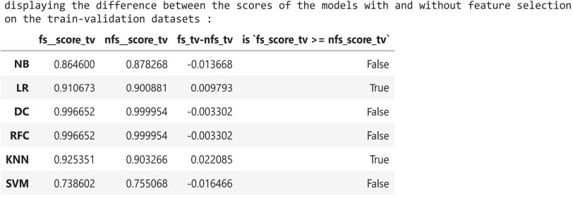
Model Metrics
difference between the scores of the models with and with out feature selection on ::
train_validation metrics :

Slide 23
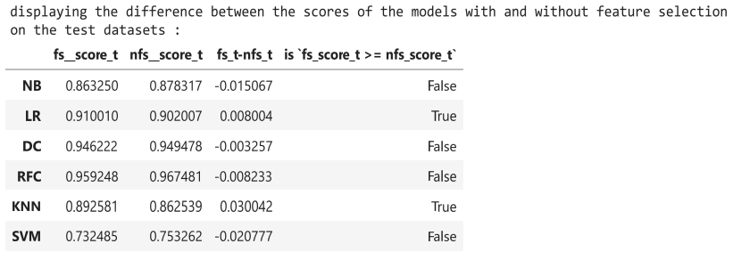
Model Metrics
difference between the scores of the models with and with out feature selection on ::
test metrics :

Slide 24
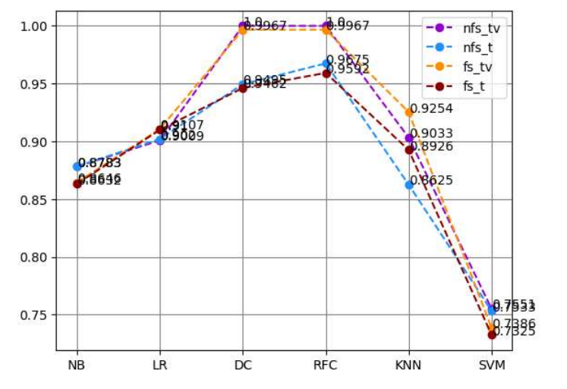
Model Metrics
plotting the scores of the models with and without feature selection on train- validation and test datasets :
interpretation : ‘RFC’ model has the highest accuracy score

Slide 25
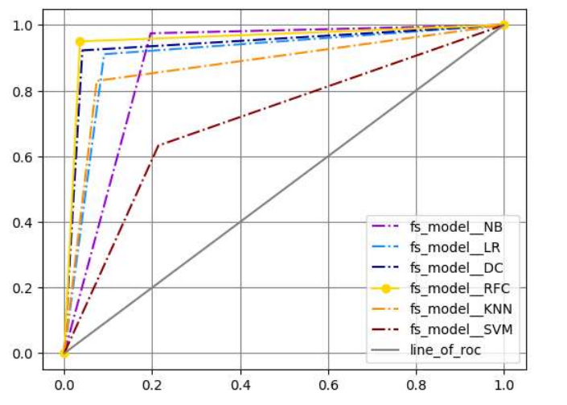
Model Metrics
plotting the ROC curve on test-dataset
interpretation : ‘RFC’ model has the highest ROC curve

Slide 26
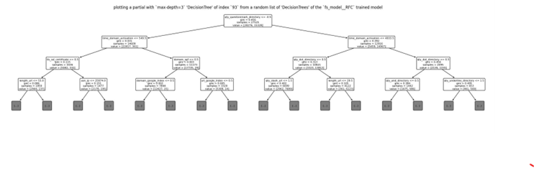
Model Vizualization
plotting a partial RFC decision tree:

Slide 27
Conclusion
On the basis of the above plots we can conclude that there is a very slight vafraiation in the accuracy of the model , when trained wit and without feature selection . so, we can consider the selected features for training the model.
Since the model RFC with feature selection has the highest accuracy with ‘0.959248’and highest ‘ROC_AUC ‘ score with ‘0.95714’ , we can consider it as the best model.

Slide 28
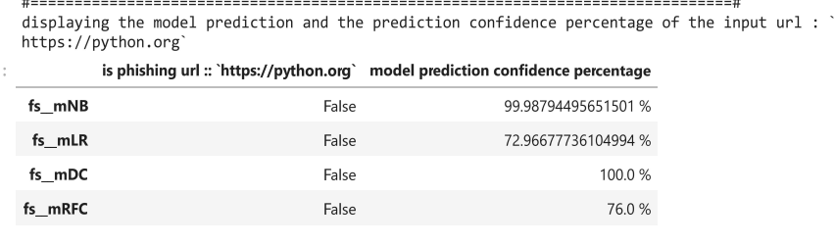
Model Deployment and Test Case
Displaying the model(s) ‘prediction score’ and ‘prediction confidence score’ for the URL ‘https://python.org’ to test if the URL is a ‘phishing’ or a ‘legitimate’ URL:
interpretation :
based on the model predictions the URL is not a ‘phishing’ URL with the confidence of ‘76.0 %’ w.r.t ‘RFC’ model

Slide 29
Reference(s)
source dataset : https://data.mendeley.com/datasets/72ptz43s9v/1
resource data description : https://www.sciencedirect.com/science/article/pii/S2352340920313202

Slide 30
Thank You

Slide 31
Any Queries ???...

Slide 32
Thank You

